Slide 1
Demo 3 Presentation
Group 13 - FarmFriend

Slide 2
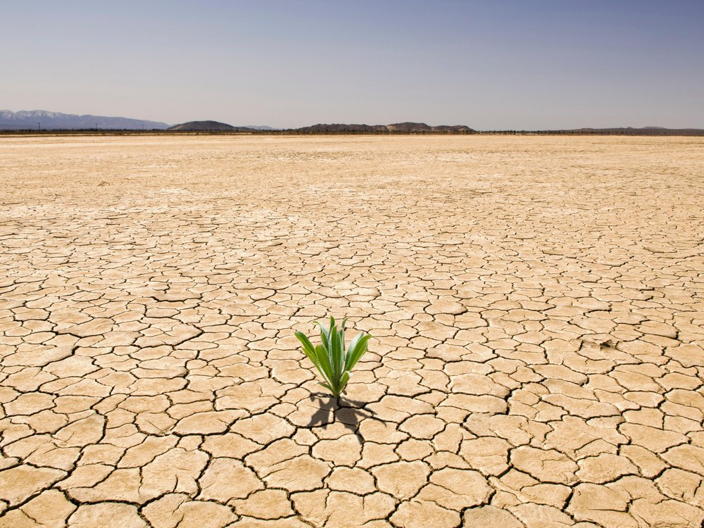
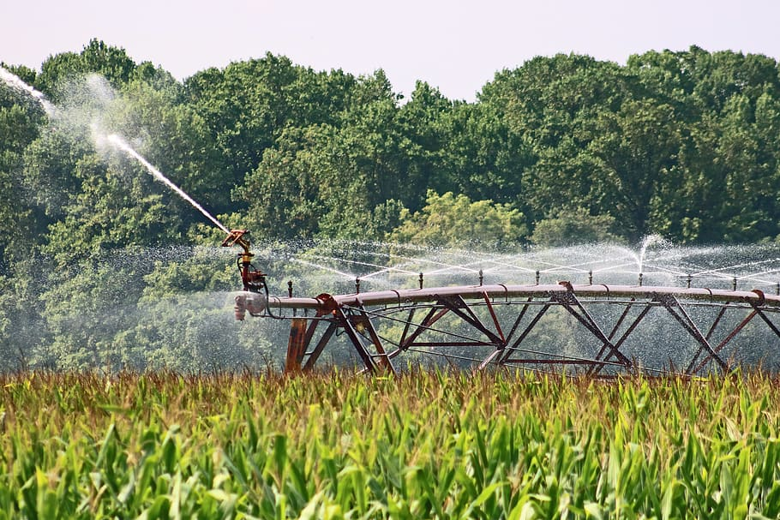
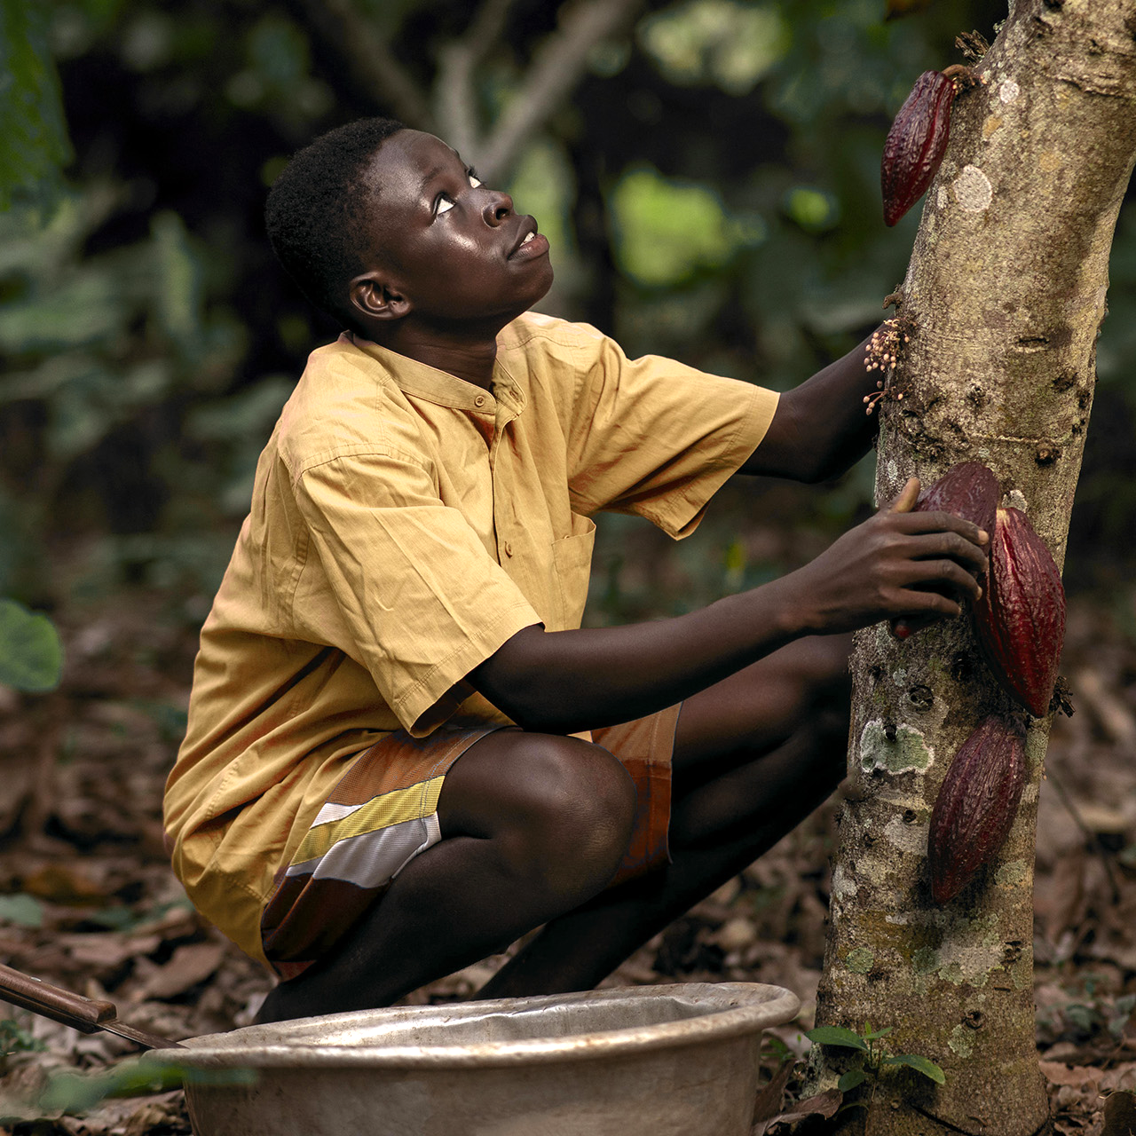
12,000,000
Hectares of land are lost annually due to drought and desertification
https://www.syngenta.com/en/innovation-agriculture/challenges-modern-agriculture
Notes:
https://www.syngenta.com/en/innovation-agriculture/challenges-modern-agriculture

Slide 3

Introduction
The FarmFriend robotic system monitors soil health, and can act to varying levels of pH by stabilising soil to an optimal pH.

Slide 4
Project process
Demo 1
Demo 2
Demo 3
Reactive
Web App
Component to react to different soil pH levels
Analytics from the data collected
Sensors
Navigation
Components to take soil measurements
Autonomous navigation of the system

Slide 5
Table of contents
Value Proposition
Overview
01
02
Progress
Demonstration
03
04
Summary and motivation behind the project
How the system is envisioned to be used
Technical progress made thus far
Physical functional demonstration of the robot

Slide 6
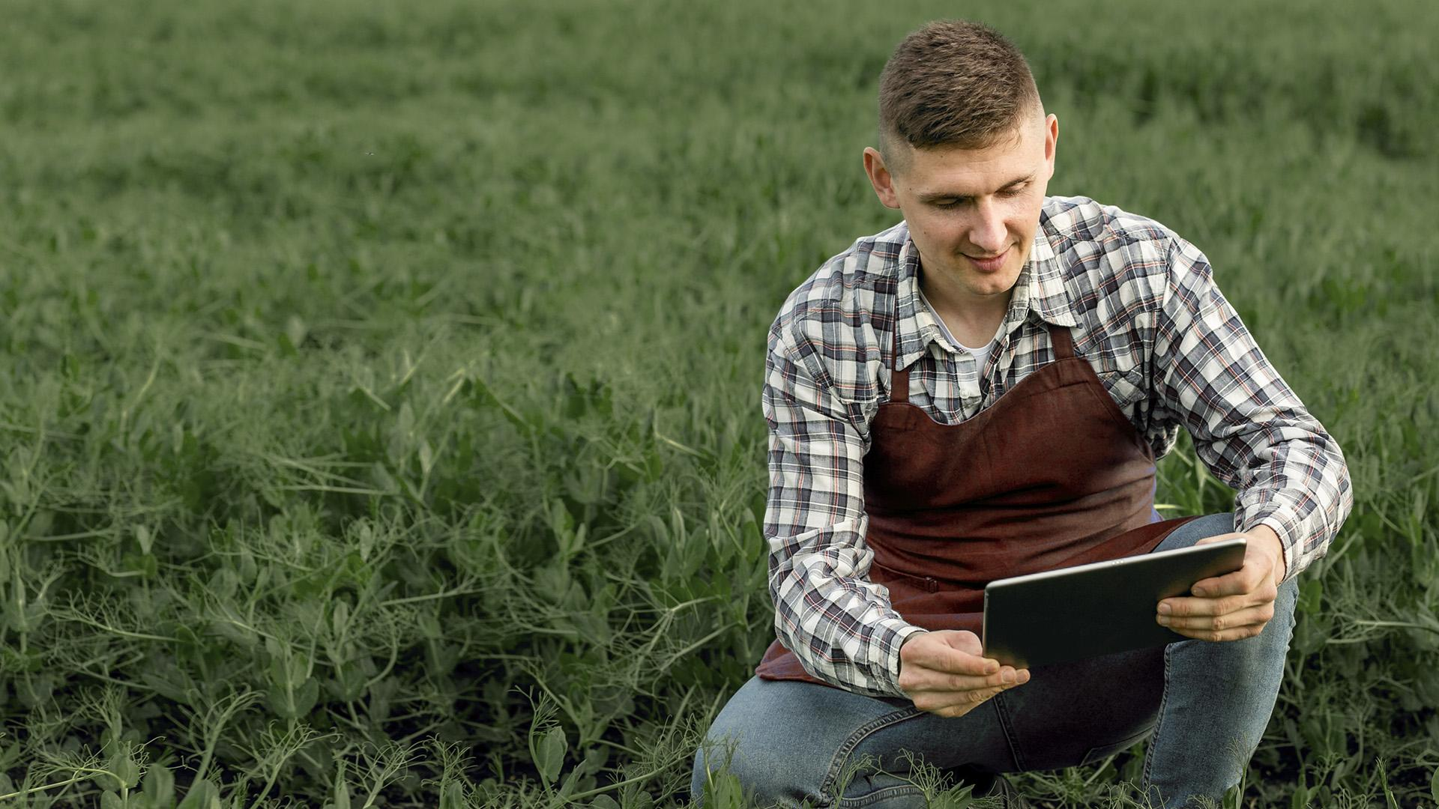
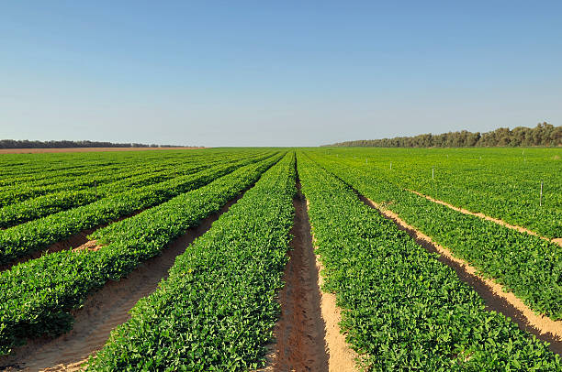
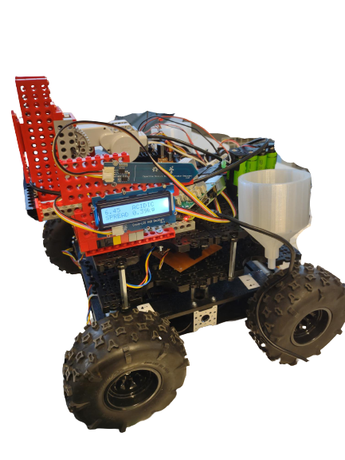
Segmentation of the field
Navigate
Sense
React

Slide 7
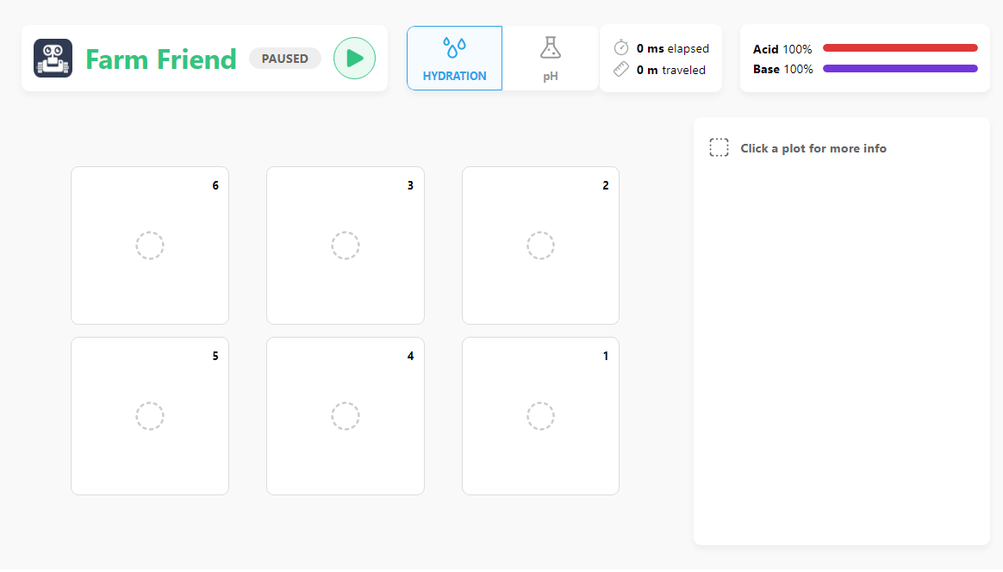
Web App

Slide 8
01
Value Proposition
Why is there a market?

Slide 9
Who would use it?
Farmers
Nutrient providers
Our primary user, monitoring soil health
Reactive element fitted with nutrients
Optimising the productivity of individual plants through smart precision farming.

Slide 10
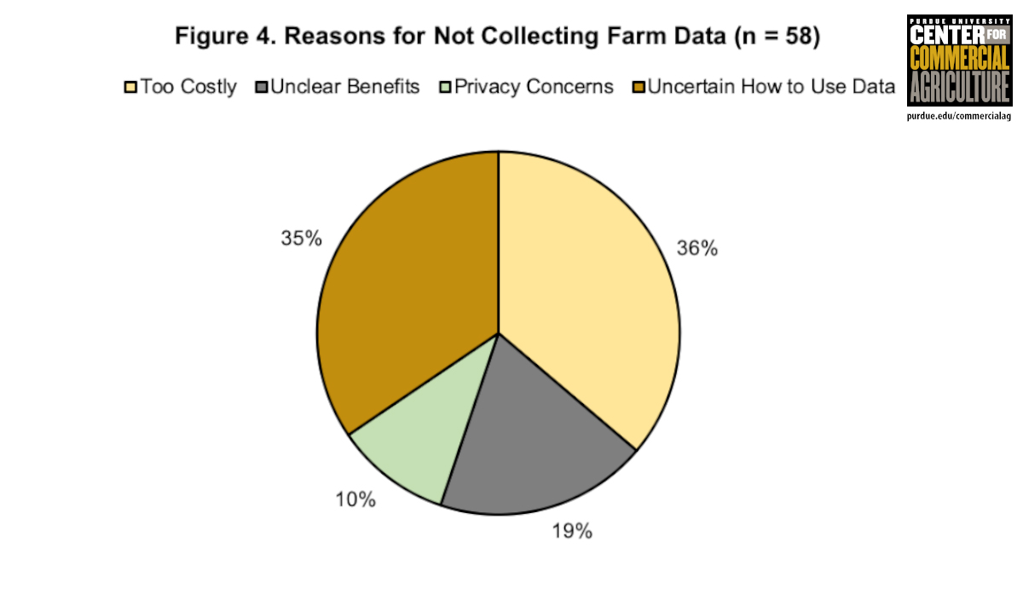
https://www.sciencedirect.com/science/article/pii/S1573521418302616
Notes:
According to (Nathan DeLay, 2020), 38% of farmers surveyed believed data collection too costly, and 35% were unaware of how to use the data effectively. This shows a large market gap for our system, as an affordable alternative to more expensive solutions. With the web app we can present the understandable data to the user allowing them to see exactly which part of their field is not optimal.

Slide 11
Why not IoT?
“Agriculture margins make tech investment tough.” ^{[1]}
How can farmers maintain IoT themselves?
Average cost of IoT infrastructure
IoT is complex
$500 /acre
$100,000 per field
https://readwrite.com/iot-agriculture-costs-it4/
https://ourworldindata.org/farm-size
Notes:
https://readwrite.com/iot-agriculture-costs-it4/

Slide 12
02
System Overview
How does it work?

Slide 13
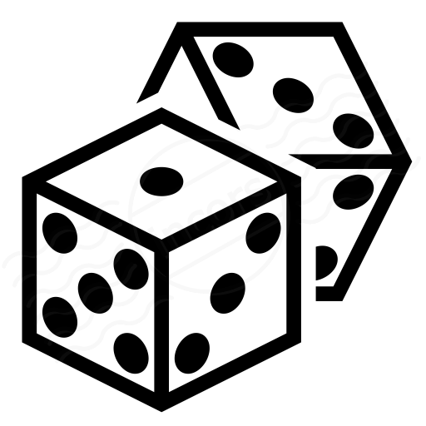



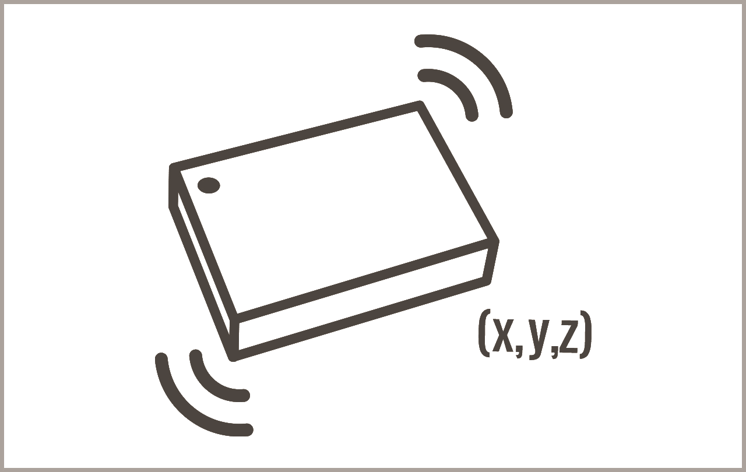
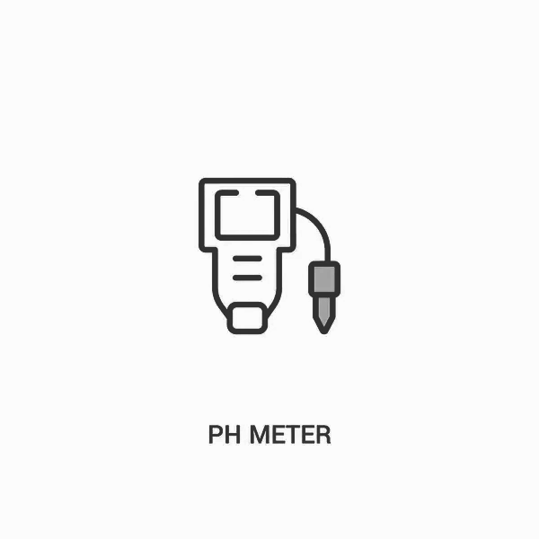
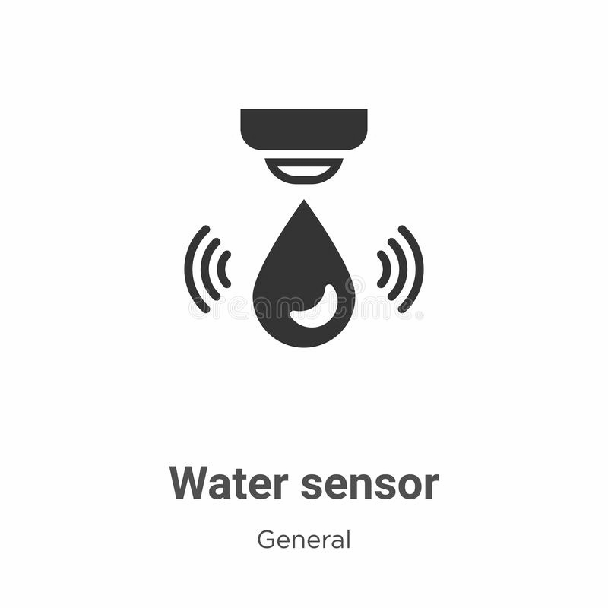
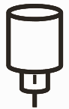

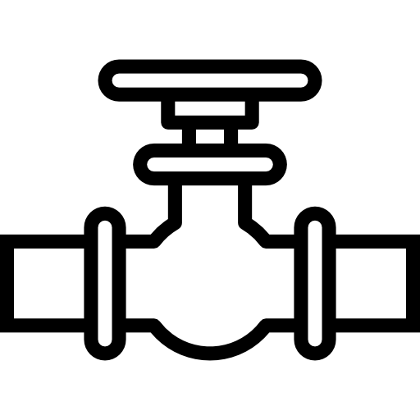
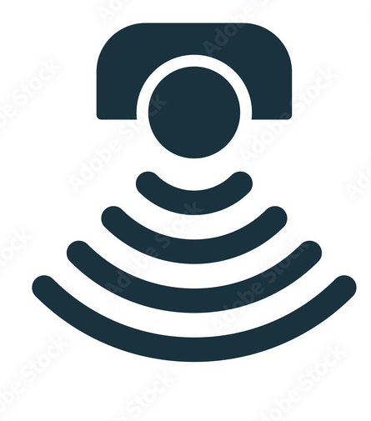
System Design
DICE
DICE
RASPBERRY PI
RASPBERRY PI
Prowler
Prowler
Camera
IMU
Reactive Motors
Reactive Motors
Valves
Ultrasonic sensors
Rotary Encoders
Rotary Encoders
Notes:
We chose the prowler for its larger wider wheels, which provides a larger surface area to distribute the weight of the chassis onto; which means that we are able to minimise the damage to the crops.
The prowler base is also significantly more powerful as compared to the standard turtlebot; however it brings more challenges such as having our own wheel encoders and navigation system.
As opposed to a Raspberry Pi to control the sensor motor, we use an Arduino. This allowed us to modularise the development and since the moisture sensor is an arduino component it kept the entire sensor sequence in one place. Another reason is that it is easier using Arduino because there are off the shelf libraries, and in the case of Pi we need to write more complicated codes to achieve the same purpose.
The system is mounted on the prowler chassis
It is controlled using a Raspberry Pi, which communicates with the four motors for the wheels and the Arduino which currently controls the sensor system.
We use a DICE machine to control the Pi to run a script which starts the sequence
An Arduino controls a motor which turns a wheel to lower/lift the moisture sensor and the sensor itself is connected to the Arduino. A display shows the moisture reading (higher -> dryer).

Slide 14
03
Technical Progress
What have we accomplished?

Slide 15
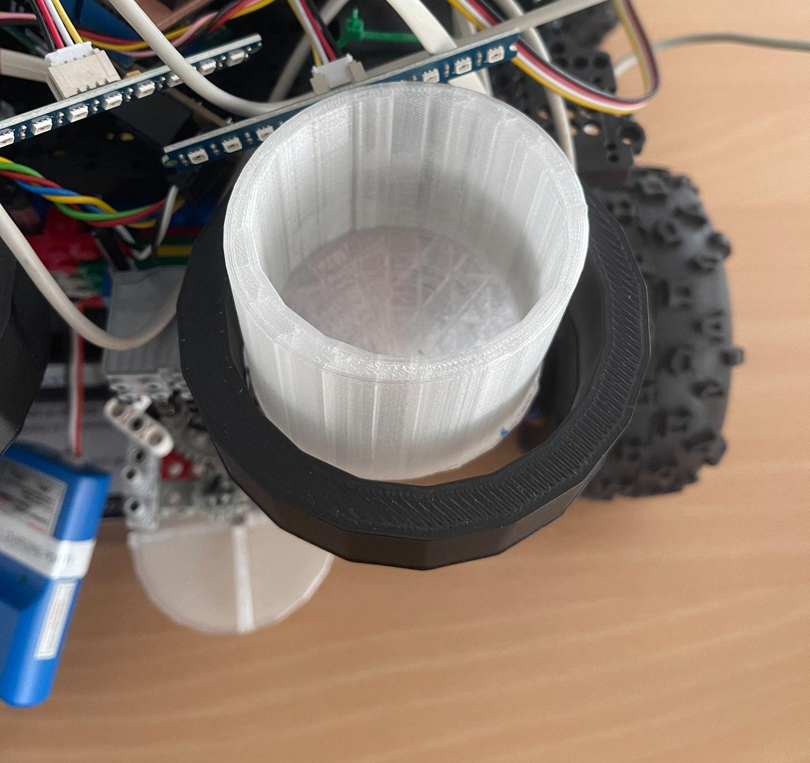
Reactive-Chemical containers

Slide 16
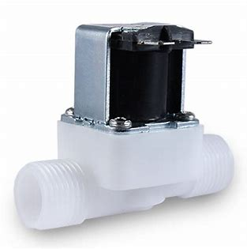
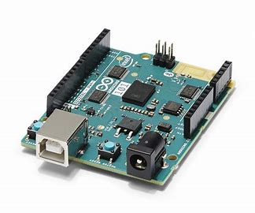
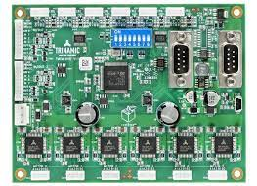
Reactive-Valve
To control the spread of the chemicals
Valve | Motor board | Arduino

Slide 17
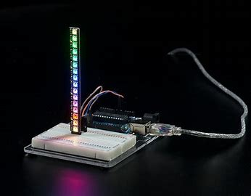
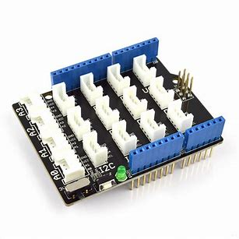
Reactive-LED bar
LED bar | Grove shield | Arduino

Slide 18
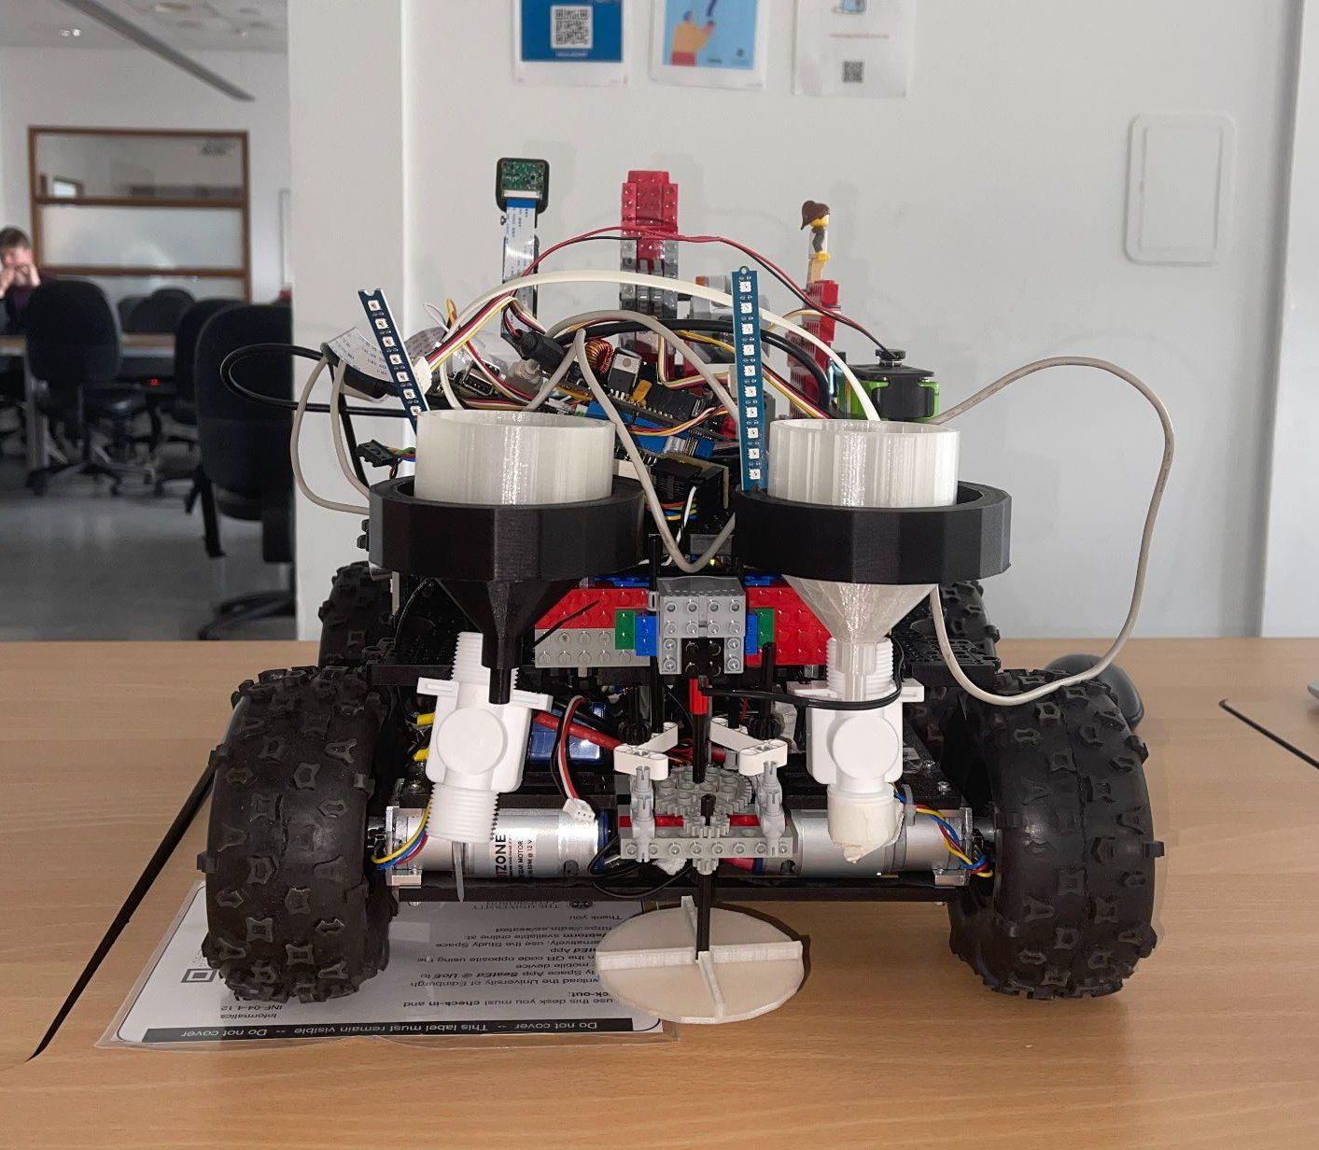

Reactive-demo video

Slide 19
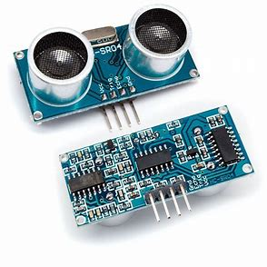
Navigation-Distance sensor
Ultrasonic sensor | Grove shield | Arduino

Slide 20
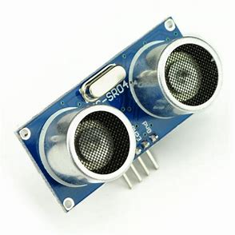
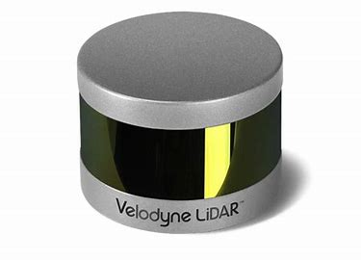
How to navigate?
Cheaper
Precision
Easy integration
OR
Ultrasonic sensor
LIDAR
At least 50x cheaper
Baud rate considerably lower - not suitable for dynamic scenarios
Ultrasonic sensor is a more versatile option
https://www.seeedstudio.com/blog/2019/12/23/distance-sensors-types-and-selection-guide/

Slide 21
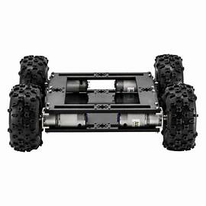
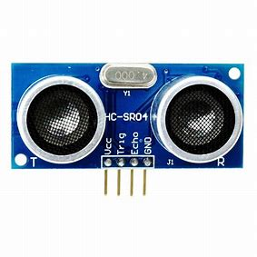
Navigation-Ultrasonic sensors
Side distance sensors：
Keep the robot at the center of the road
Side distance sensors：
Keep the robot at the center of the road
Front distance sensor：
Prevent collision while driving

Slide 22


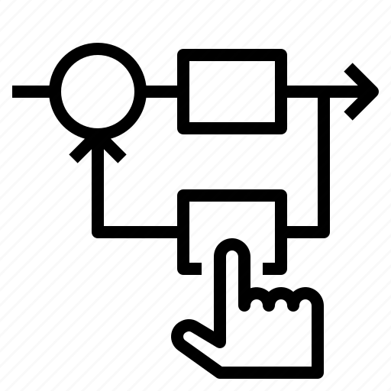
Progress addressing demo 2 feedback
Web app
Navigation
Control Feedback
Interface between user and system
Working system. Considered edge cases using IMU
Allowed by use of wheel encoders

Slide 23
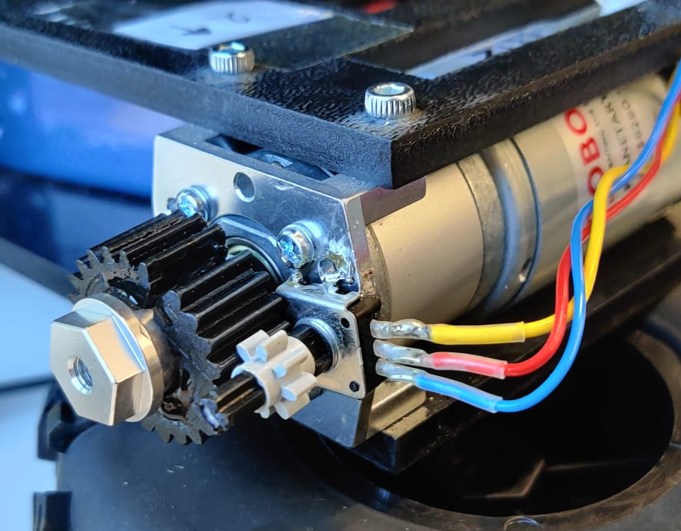
Navigation-wheel encoders
Wheel encoder | Grove shield | Arduino

Slide 24
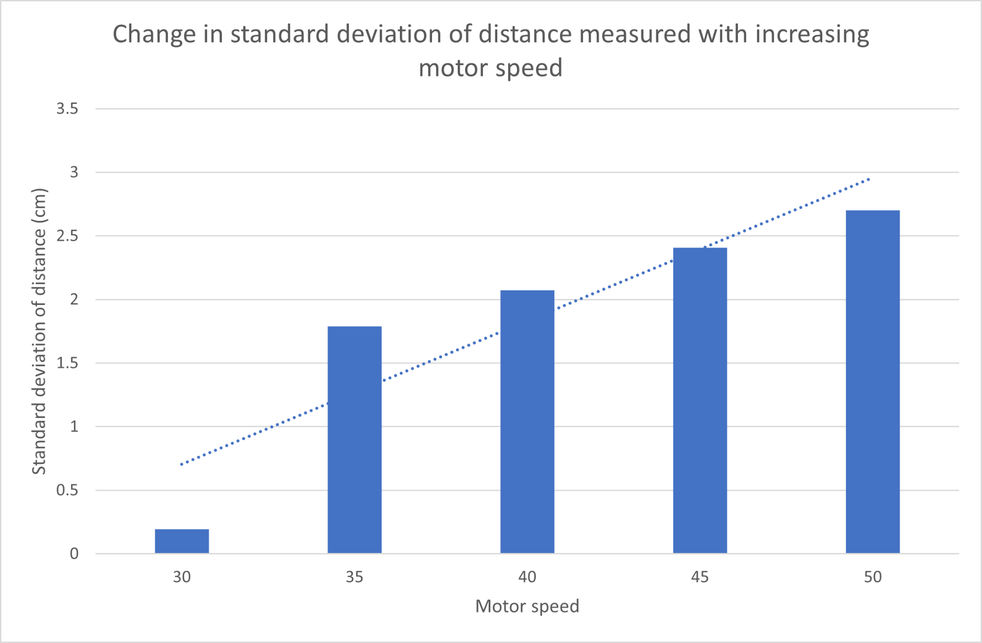
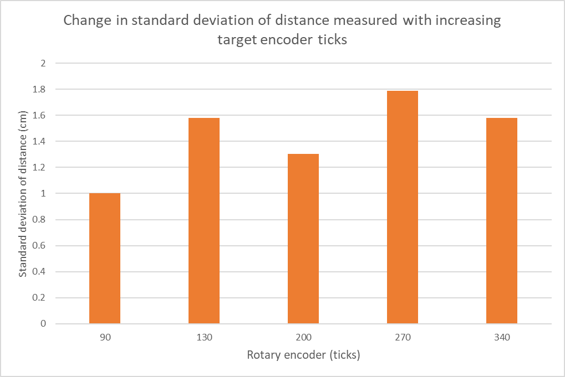
Control feedback (rotary encoder)
Before
After

Slide 25
04
System Demo
Let’s see it working!

Slide 26

Questions?

Slide 27
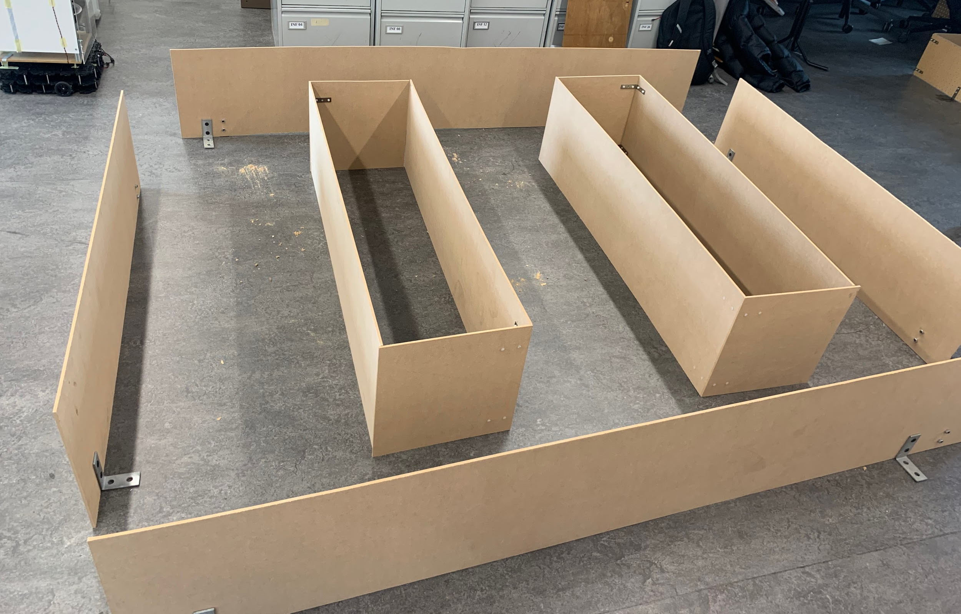
Ground layout

Slide 28
Navigation-demo video

